Slide 1

Power BI
Presentation
This presentation outlines the process of utilizing Power BI dashboards for analyzing sales, profitability, and operational efficiency. We'll explore actionable insights derived from data analysis and discuss how to leverage these findings for informed decision-making and optimization.
By Group 11

Slide 2

Problem Statement
1
Objective
2
Data Insights
This analysis aims to leverage Power BI dashboards to understand and improve sales, profitability, and operational efficiency.
The goal is to uncover actionable insights from univariate, bivariate, and multivariate data analyses for effective decision-making.
3
Performance Optimization
We seek to optimize performance by identifying key areas for improvement based on data-driven insights.

Slide 3

Understanding the Data
Metric
Description
Sales
Revenue generated from product or service sales.
Cost of Sales
Direct costs associated with producing goods or services sold.
Marketing Costs
Expenditures on marketing and advertising campaigns.
Operating Expenses
Indirect costs related to running the business, such as rent, utilities, and salaries.
Net Profit
The difference between total revenue and total expenses.

Slide 4

Power BI: Key DAX Functions and Measures
Function
Description
Example
Use Case
SUM
Aggregates values by summing them.
Total_FTP = SUM(tbl_GL[Amount])
Calculate total sales or costs.
AVERAGE
Calculates the mean of values.
Average Sales = AVERAGE(Sales[Sales Amount])
Analyze average metrics like sales per transaction.
CALCULATE
Modifies the context of a calculation.
EBIDTA = CALCULATE([Total_FTP],tbl_ChartofAccounts[SubClass]="Operating Expenses")
Calculates EBIDTA
IF
Implements conditional logic.
Profit Status = IF(Sales[Profit Margin] > 0.2, "High", "Low")
Categorize data based on thresholds.
FILTER
Applies row-level filters.
Filtered Sales = CALCULATE(SUM(Sales[Sales Amount]), Sales[Region] = "USA")
Analyze regional or segment-specific data.

Slide 5
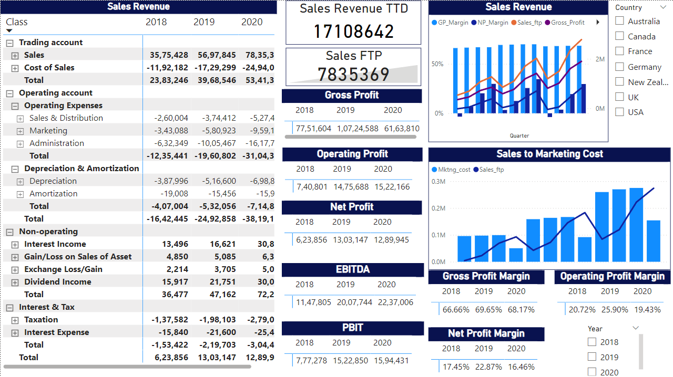
Graphs and Dashboards

Slide 6
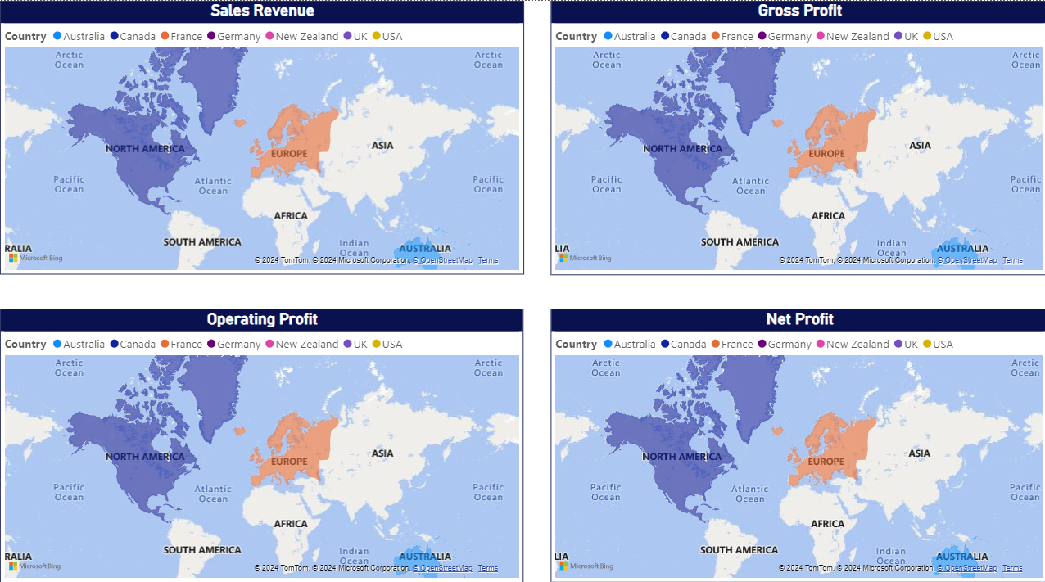
Graphs and Dashboards

Slide 7

Insights from Graphs
1
Sales Trend
2
Marketing ROI
Sales revenue demonstrates consistent growth across regions, with the USA achieving the highest performance.
Marketing costs are proportionate to sales, indicating effective marketing spend and a positive return on investment.
3
Profit Margin Fluctuations
4
Financial Efficiency
Net profit margin reflects steady profitability, indicating sound financial management and efficiency.
Operating profit margin peaked in 2019 but dropped slightly in 2020 due to increased costs.

Slide 8





Business Recommendations
Maximize Revenue
Focus on high-performing regions like the USA to drive revenue growth.
Improve Profit Margins
Optimize operational costs and identify areas for cost reduction to enhance profitability.
Address Cost Increases
Analyze the reasons behind the increase in costs in 2020 and implement strategies to address inefficiencies.
Maintain Marketing ROI
Continue leveraging effective marketing strategies to maintain a high return on investment.

